Slide 1
BBB

Slide 2
Inhoudsopgave

Slide 3
Project aim – research questions
Research question: How does the degree distribution in the Bianconi-Barabasi model depend on the fitness distribution in the network? Simultaneously, can we find the fitness distribution of real-world networks based on the time evolution of the degree of the nodes? Finally, can we observe the phase transition where a finite fraction of the nodes is linked to a single node?

Slide 4

Hypothesis
Hypotheses: The degree distribution will follow a power-law, precisely like the BA model, if the fitness distribution has a finite domain. The node with the highest fitness value will draw a lot of other nodes in the second instance if the fitness distribution has an unlimited domain, resulting in a situation winner takes all phenomenon. We will therefor find in the plots a powerlaw disitbution with the exponent comparable to __ (from analysis).
It is possible to recreate the fitness distribution based on the degree distribution of real-networks that were created in a Biaconni-Barabasi fashion.

Slide 5
Bianconi-Barabasi Networks
What is it?
Preferential attachment
Fitness
Phase transitions
Maths

Slide 6
Basics of the Bianconi-Barabasi Networks
Added feature: Fitness
Preferential attachment based on that fitness
New emergence behaviours:
Winner-takes-all phenomenon vs. Richer-get-richer

Slide 7

Preferential attachment
Add nodes with preferential attachment:
$Π_{i}=\frac{η_{i}k_{i}}{\sum_{j}{η_{j}k_{j}}}$

Slide 8
Fitness
What is fitness?
Fitness is unchanged once assigned
Drawn from distribution
Research question: How does it affect the degree distribution

Slide 9
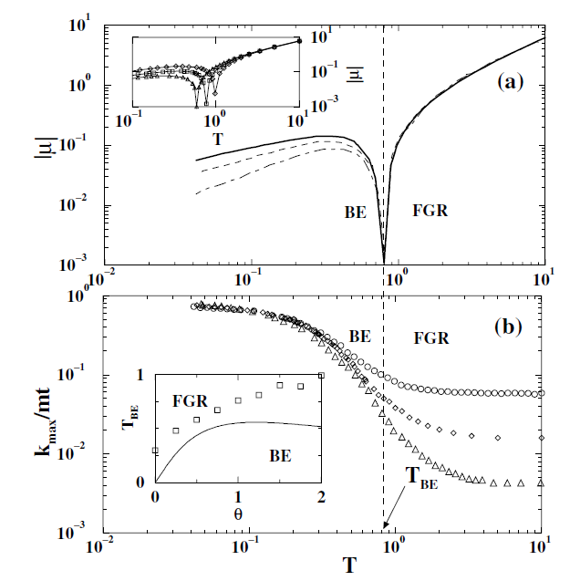
Phase transition

Slide 10
Maths

Slide 12
Real data

Slide 13
Conclusions

Slide 14
Questions

